Slide 1

The Parents’ Guide to
Google Classroom

Slide 2

What is
Google Classroom?
Think of Google Classroom (GC)
as your child’s digital link to learning.
Teachers use GC to share assignments, homework, newsletters, and much more with students AND parents!

Slide 3
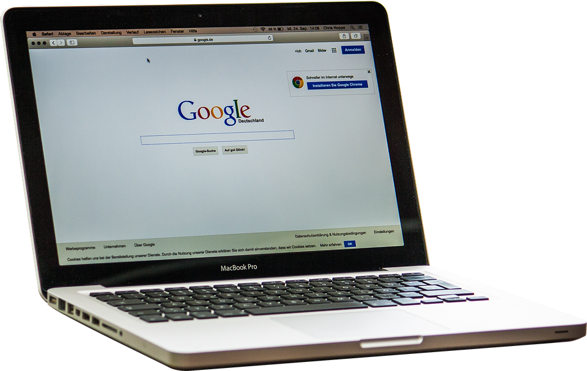
Getting Started
Your child was provided with a secure login and password that is unique to them.
Check with his/her teacher to obtain this private information OR ask them to add you as a parent via email!

Slide 4



Getting Started
Go to Townsend Webpage

Slide 5

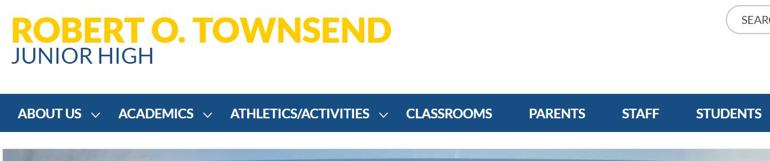

Getting Started
Click on STUDENTS.

Slide 6
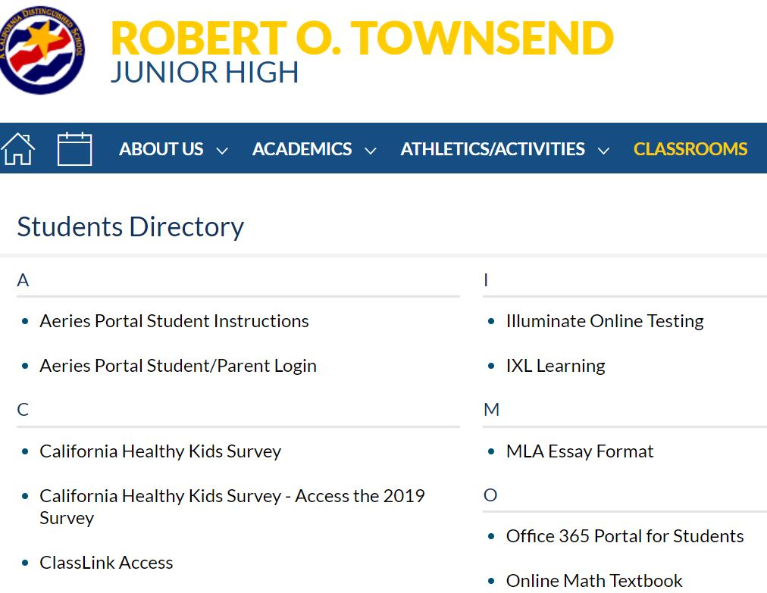


Getting Started
Click on Classlink Access

Slide 7

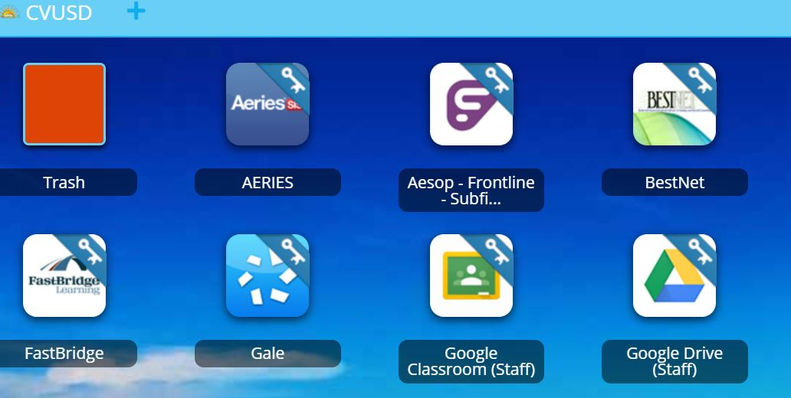

Getting Started
Click on Google Classroom (student)

Slide 8

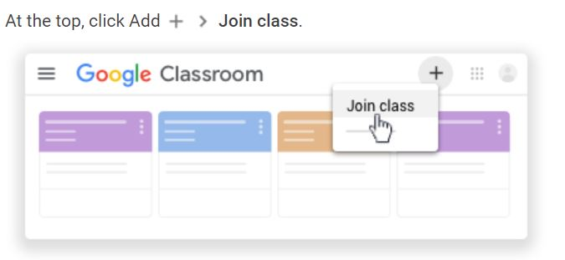
Getting Started
Enter the class code and click join
we5souz

Slide 9
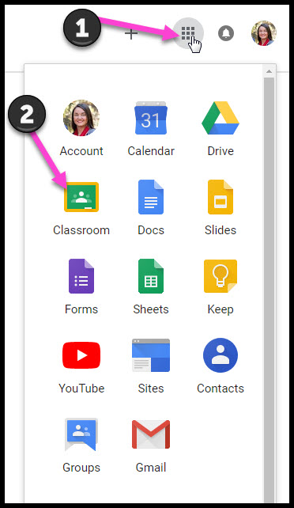
Navigating Classroom
Click on the waffle button and then the
Google Classroom icon.

Slide 10
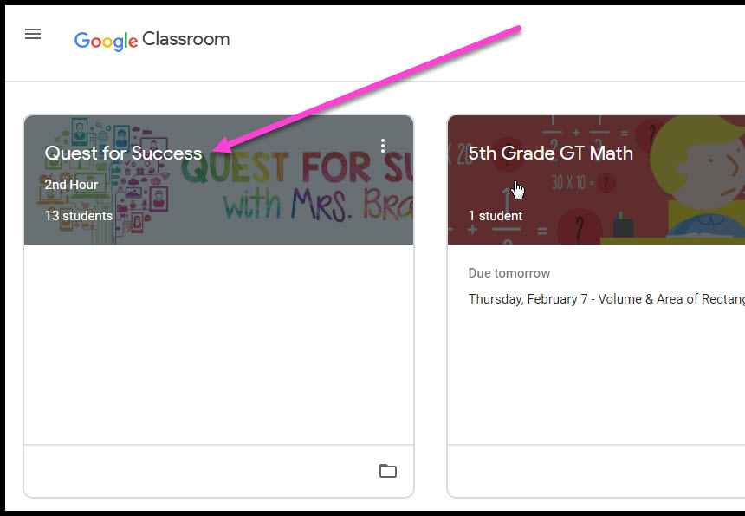
Navigating Classroom
Click on the class you wish to view.

Slide 11

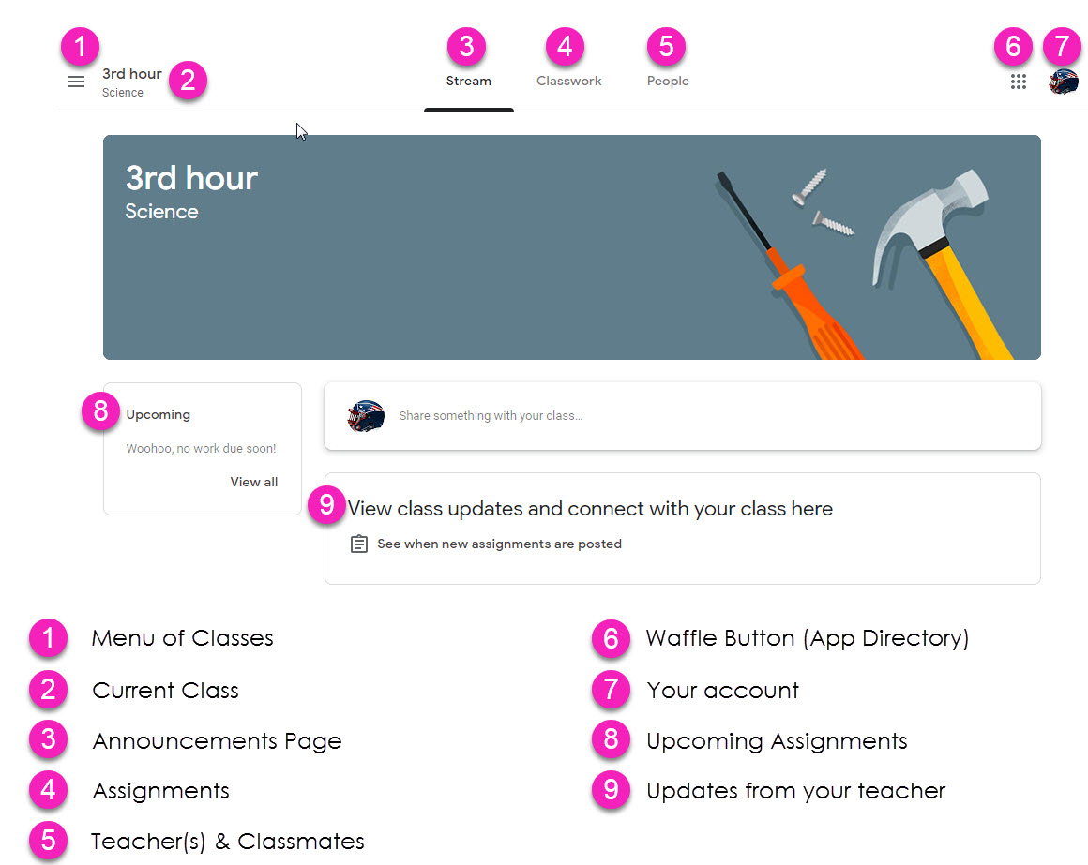
Navigating Classroom
= High Interest for Parents
Page tools
(Left side)

Slide 12
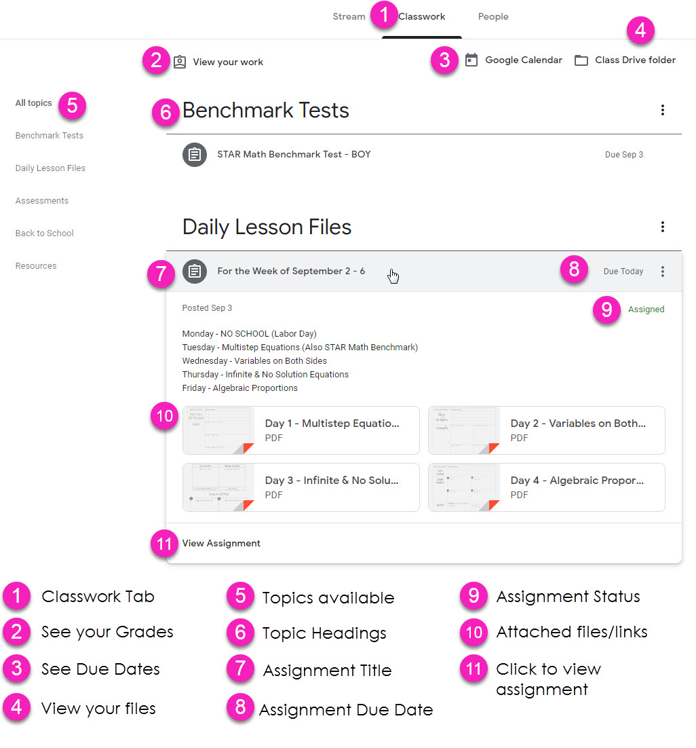
Navigating Classroom
Assignment details

Slide 13

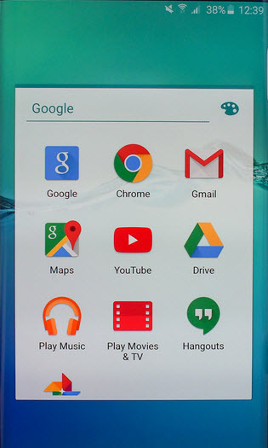
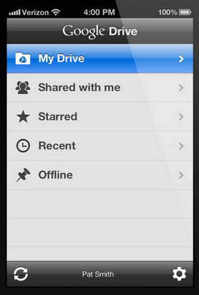
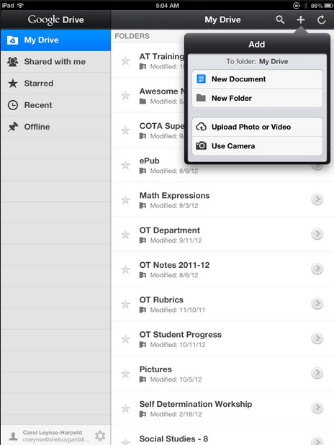
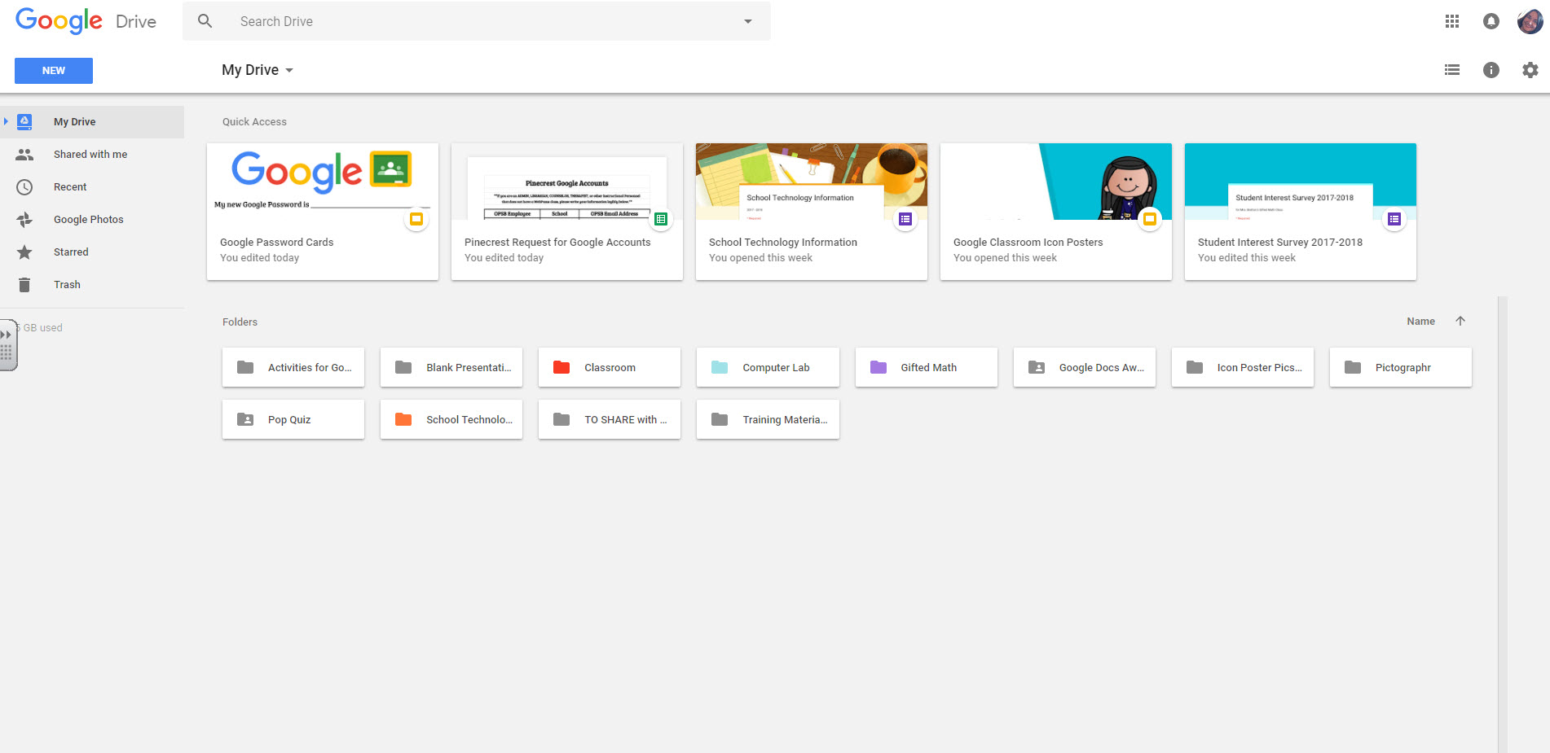
access
anywhere
Android
Iphone
Tablet
desktop

Slide 14


GOOGLE APPS
allow you to edit Google assignments from
any device that is connected to the internet!

